Slide 1
Why I Am A
Hyperdispensationalist 3
Cornelius (part 2)

Slide 2
Why I Am A
Hyperdispensationalist 3
Cornelius
“Prophecy program” and “Mystery program” are not found in God’s Word.
Cornelius and his house already had personal, eternal salvation.
Many Gentiles will receive the inheritance promised to Israel.

Slide 3
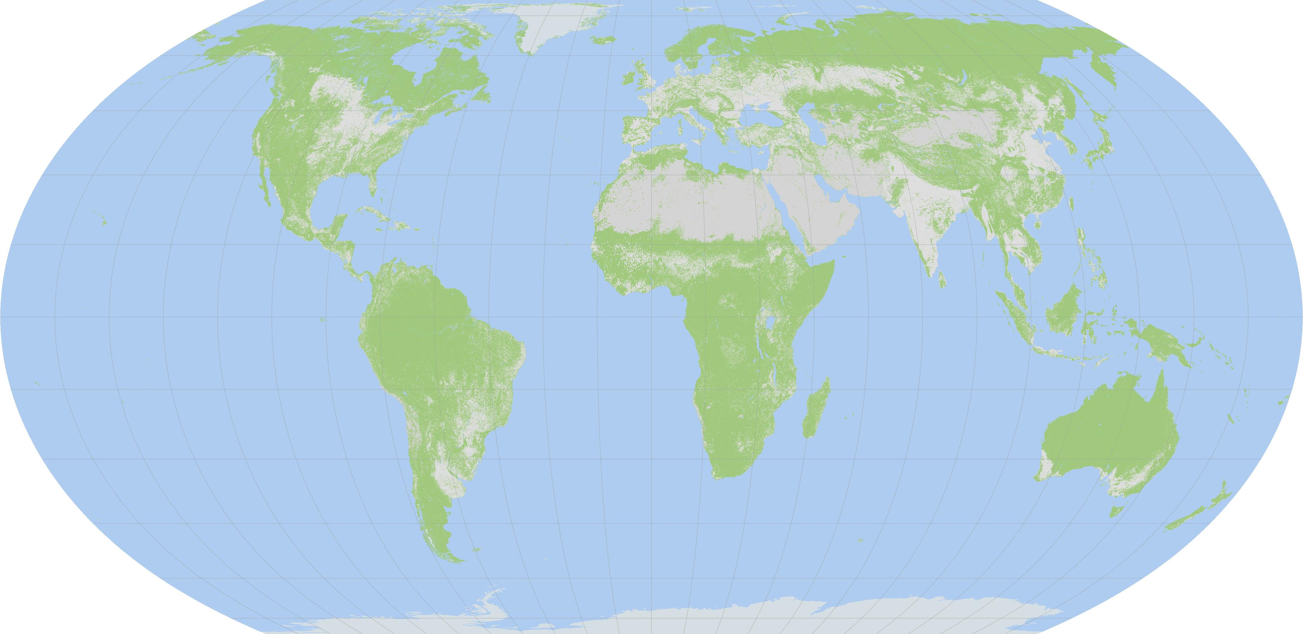
The land promised to Israel that many Gentiles will become part of.
Christ’s Earthly kingdom during the 1000 year reign. The part outside the black box is what is inherited by the Gentiles of Matt. 25: 30-46.

Slide 4
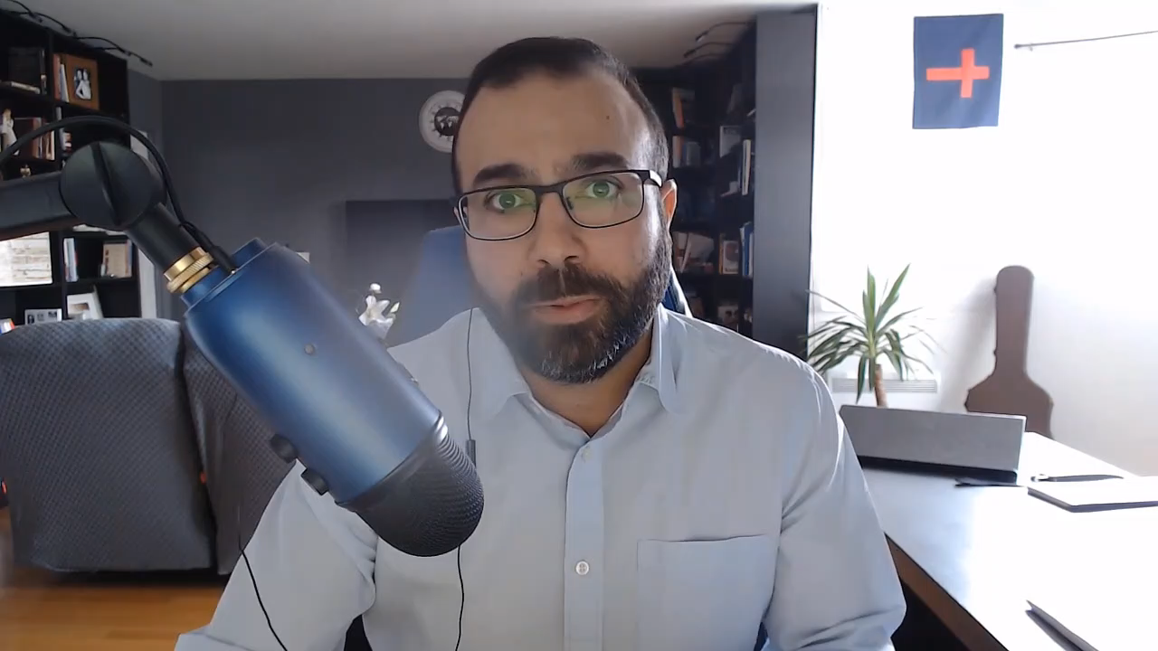

Slide 5
Pastor O’Steen contends that the water baptism of Acts 2 and Acts 10 were for power (Acts 1:8).
Dr. Antonius believes that the baptism of Acts 2 is for individual, eternal salvation (the remission of sins).
Power is given by the Holy Ghost – not water baptism.

Slide 6
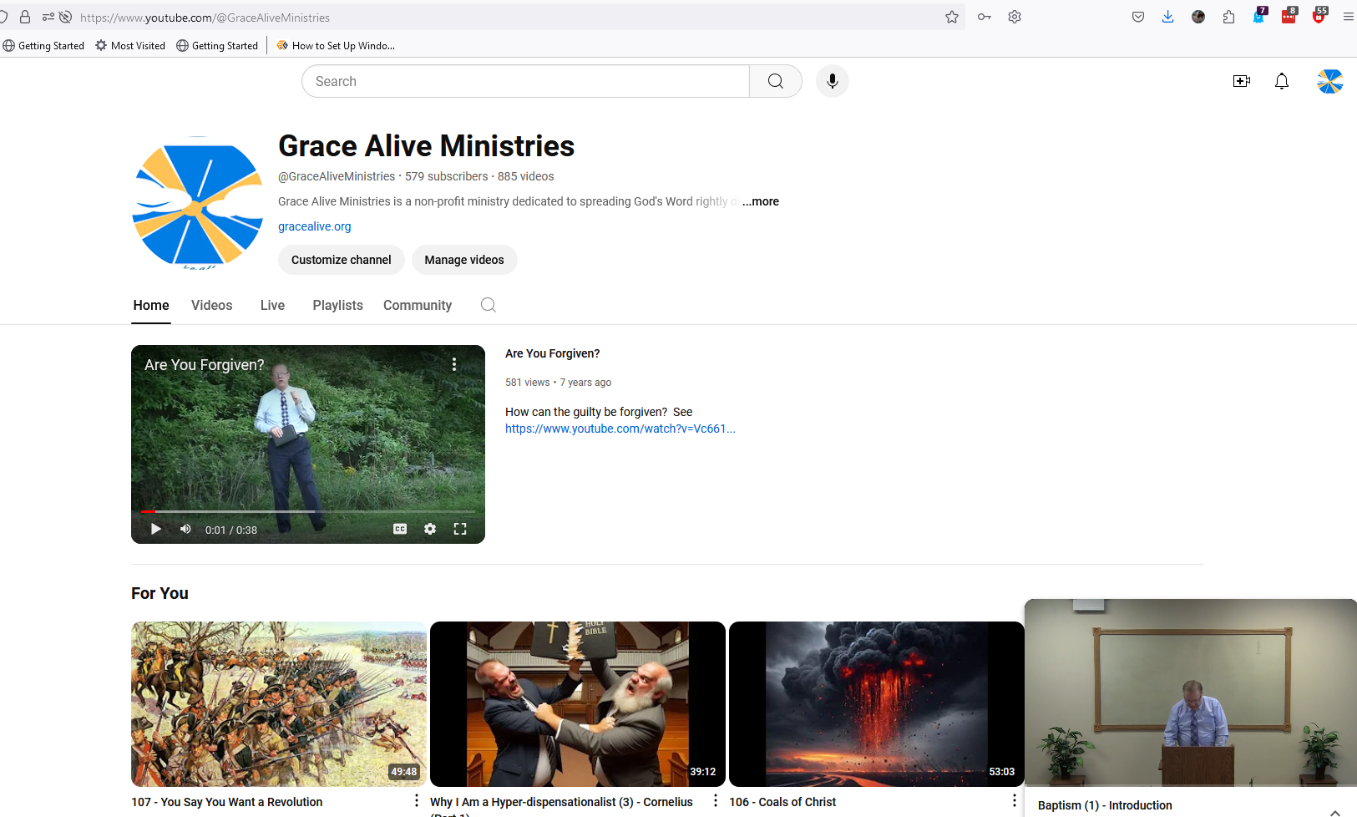



https://www.youtube.com/@GraceAliveMinistries

Slide 7
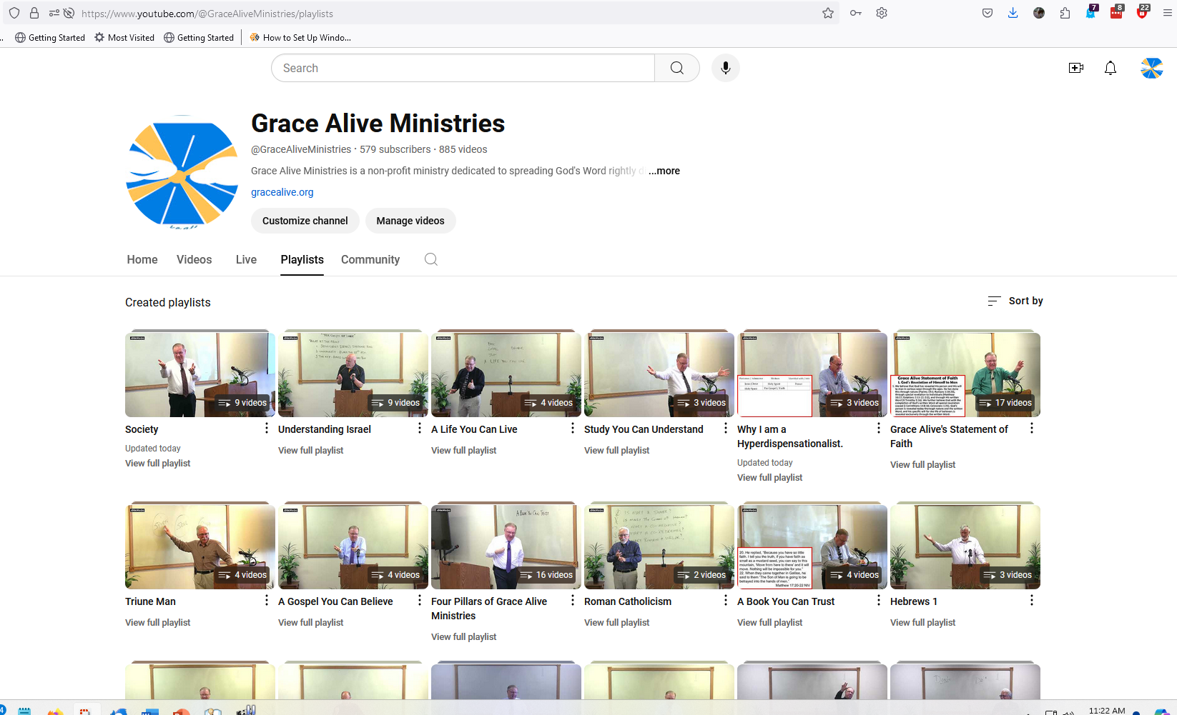

Slide 8
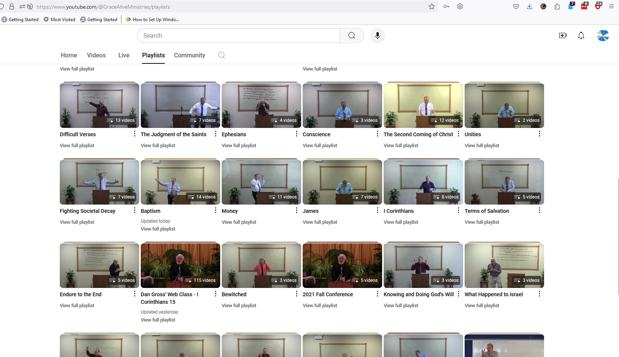


Slide 9
Water Baptism is NEVER for personal, eternal soul salvation.
The remission of sins that “every one of you” (all the house of Israel) are to be baptized for is the remission of ISRAEL’S sins, NOT the individual sins of the people there.
The Gospel for individual soul salvation was that one believes that Jesus is the Christ, the Son of God.

Slide 10
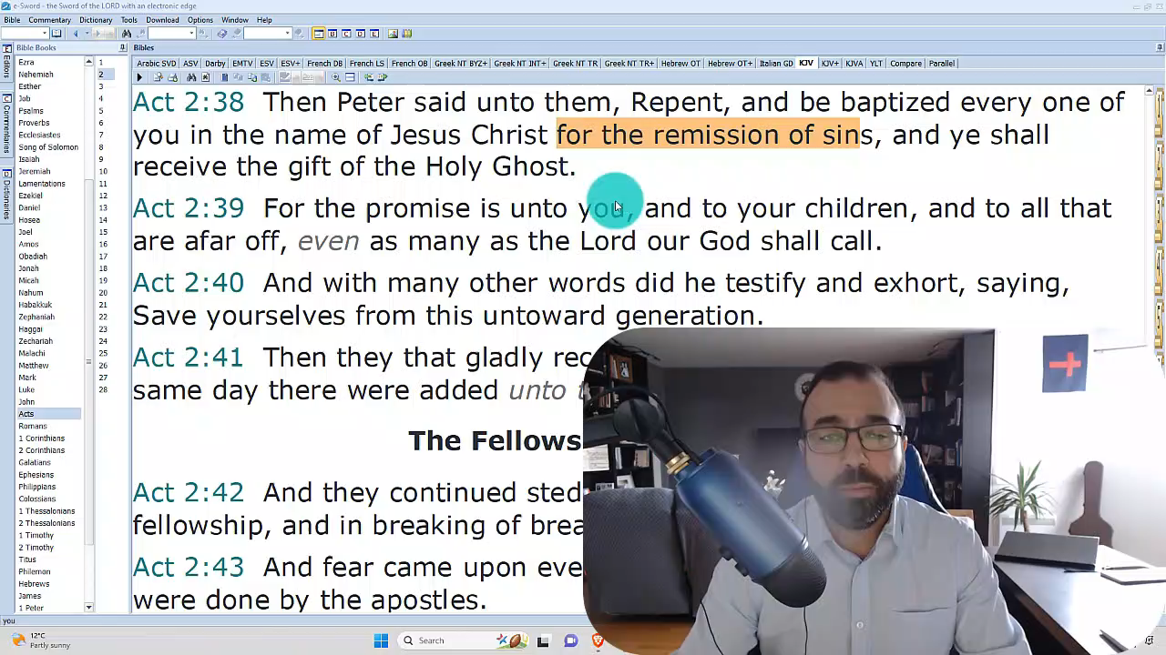

Slide 11
The Gospel of the kingdom requires water baptism. (Mark 16:16)
Peter didn’t mention water baptism before the Holy Ghost fell on Cornelius and his house.
Therefore Peter was not preaching the gospel of the kingdom.
If Peter wasn’t preaching the gospel of the kingdom, he had to be preaching the gospel of grace.

Slide 12
The Time of Jacob’s trouble
Cast out devils – As in the time of Christ, unclean spirits will be prevalent at that time. | Isa. 8:19; 19:3; 29:4; Dan. 8:23-25; Mic. 2:11; Zech. 13:2; Matt. 7:22; Rev. 9:20; 16:14; 18:2
They shall speak with new tongues – They will need to speak with new tongues to preach to every creature. | Mark 16:15 with Rev. 5:9; 7:9; 10:11; 13:7; 14:6; 17:15

Slide 13
The Time of Jacob’s Trouble
They shall take up serpents | Rev. 9:19
If they drink any deadly thing, it shall not hurt them | Rev. 8:10-12
They shall lay hands on the sick, and they shall recover | Matt. 24:7; Luke 21:11; Ezek. 6:12; 14:19

Slide 14
If you understand that the Ethiopian eunuch already had eternal life, but when he heard the message being preached to Israel and believed it, he was saved into the land inherited by Israel
AND
You understand that Cornelius and his house already had eternal life, but was told to send for Peter and: “he shall tell thee what thou oughtest to do.” And what Peter commanded him to do was to be baptized,
THEN
Mark 16:16 is not so very difficult.

Slide 15
The land promised to Israel that many Gentiles will become part of.
Christ’s Earthly kingdom during the 1000 year reign. The part outside the black box is what is inherited by the Gentiles of Matt. 25: 30-46.

Slide 16

The Gospel of the Kingdom
Believe that Jesus is the Christ, the Son of the Living God
Eternal Life
Water Baptism
Be Part of the Inheritance that was Promised to Abraham, Isaac and Jacob

