Slide 1

XX XXX
AM

Slide 2
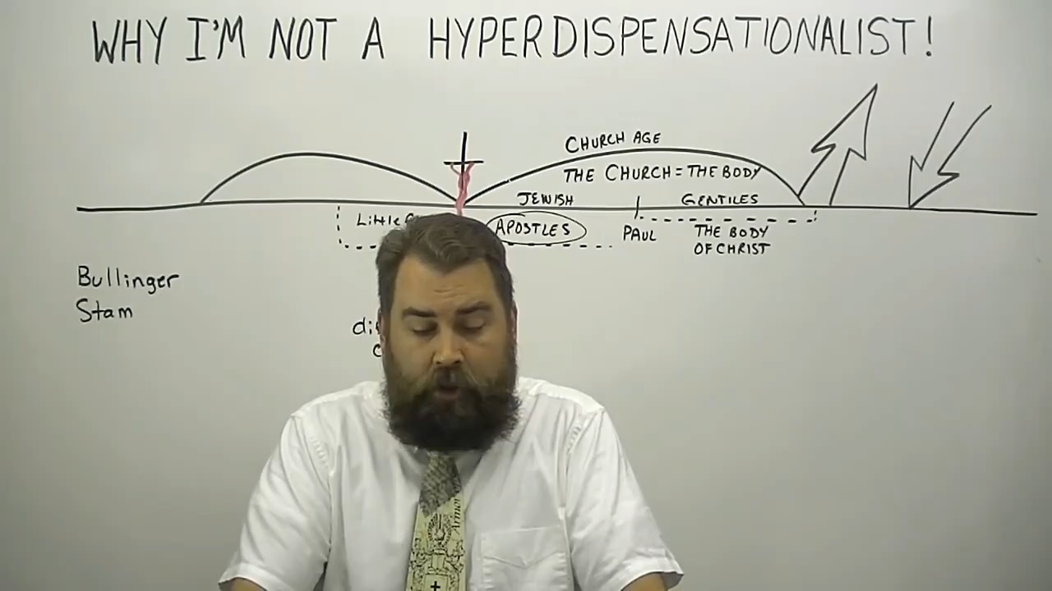

Slide 3

The Claims:
The foundation of the body of Christ is the apostles and Christ
  Conveniently ignores prophets
Apostles
Prophets
Body
Of Christ
Jesus Christ

Slide 4
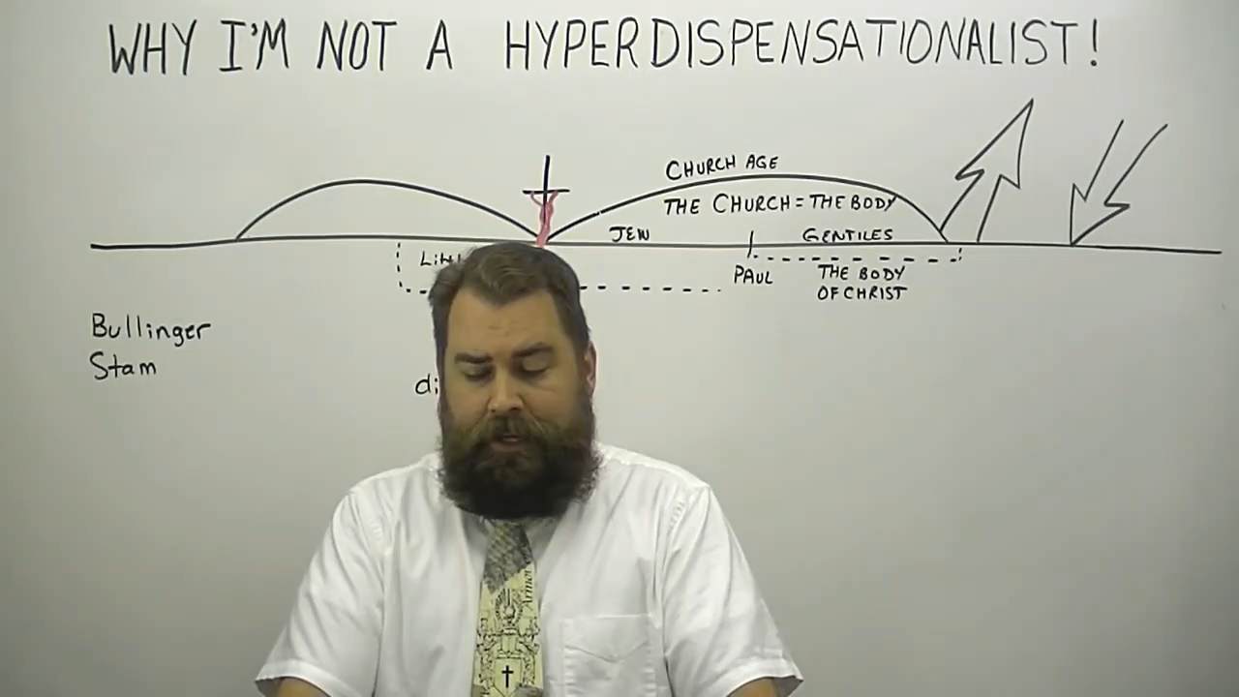

Slide 5
Apostles were the first ones placed into the body of Christ
  Assuming that
    This refers to all apostles (Not just Paul and Barnabas)
    This is the order in which people were saved into the body of Christ and not the importance of the gifts given to the early church

Slide 6
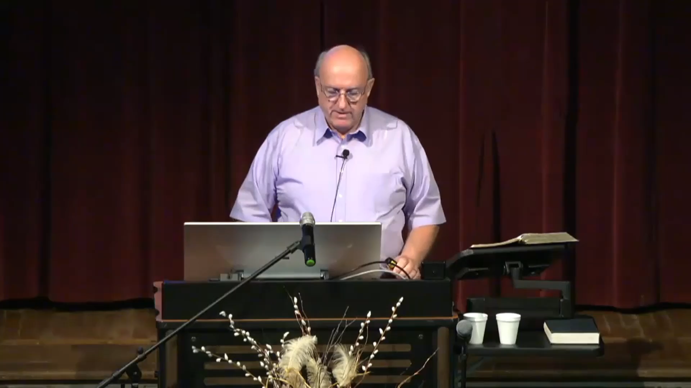

Slide 7
Assumptions:
Holy apostles means the 12
  Again, “prophets” are ignored
Were there more apostles than Paul and the 12?
Barnabas
Silas
But were there others?

Slide 8
1Cor 12:28 And God hath set some in the church, first apostles, secondarily prophets, thirdly teachers, after that miracles, then gifts of healings, helps, governments, diversities of tongues.
1Cor 12:29 Are all apostles? are all prophets? are all teachers? are all workers of miracles?
Eph 2:20 And are built upon the foundation of the apostles and prophets, Jesus Christ himself being the chief corner stone;
Eph 3:5 Which in other ages was not made known unto the sons of men, as it is now revealed unto his holy apostles and prophets by the Spirit;
Eph 4:11 And he gave some, apostles; and some, prophets; and some, evangelists; and some, pastors and teachers;

Slide 9


Jesus Christ | Matt. 13:57; 21:11; Mark 6:4,15; 8:28; Luke 1:76; 4:24-29; 7:16; 13:33; 24:19; John 4:19,44; 6:14; 7:40; 9:17; Acts 3:19-23; 7:37; Rev. 1:1-3 | Saul / Paul | Acts 13:1; I Cor. 14:37
John the Baptist | Matt. 11:7-13; 14:5; 21:26; Mark 11:32; Luke 7:26-28; 20:26 | Judas | Acts 15:32
Anna | Luke 2:36 | Silas | Acts 15:32
Agabus | Acts 11:27-28; 21:10 | Apostle John | Revelation 10:11
Barnabas | Acts 13:1
Simeon | Acts 13:1
Lucius | Acts 13:1
Manaen | Acts 13:1
Zacharias Luke 1:67
Caiaphas John11:49-51
Ephesian Jews Acts 19:1-6
Four daughters of Philip
the evangelist Acts 21:8-9

Slide 10
Who was the dispensation of the grace of God given to?
Who was the dispensation of the gospel of the grace of God committed to?
If the dispensation of grace and the gospel of grace were committed to Paul, who had to first be saved and subsequently instructed in these things for them to begin?

Slide 11
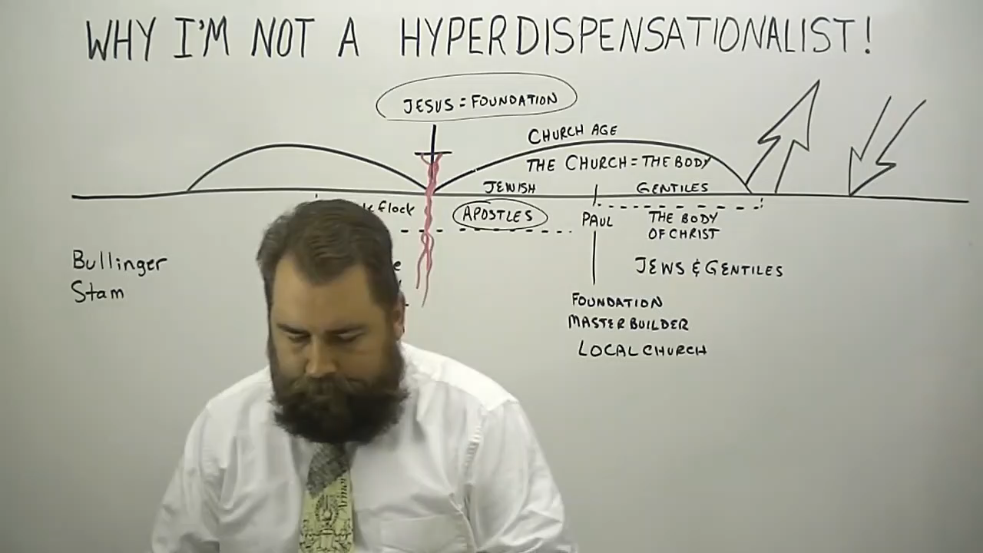

Slide 12
The Ruckmanite View:
Paul’s longsuffering was a pattern for the Body of Christ to follow.
The Shoopite View:
To read that verse as Paul being a pattern of longsuffering for the body of Christ is not only a lack of reading comprehension, it also diminishes the grace, mercy and longsuffering of our God in a fruitless effort to disprove a doctrine that is true.

Slide 13
Rom 9:22-24 What if God, willing to shew his wrath, and to make his power known, endured with much longsuffering the vessels of wrath fitted to destruction: And that he might make known the riches of his glory on the vessels of mercy, which he had afore prepared unto glory, Even us, whom he hath called, not of the Jews only, but also of the Gentiles?
Rom 2:4 Or despisest thou the riches of his goodness and forbearance and longsuffering; not knowing that the goodness of God leadeth thee to repentance?
2Pet 3:9 ¶ The Lord is not slack concerning his promise, as some men count slackness; but is longsuffering to us-ward, not willing that any should perish, but that all should come to repentance.

