Slide 1
What is that gospel? First, it is the realization that you (all of us) are sinners.
Rom 3:10-18 As it is written, There is none righteous, no, not one: 11 There is none that understandeth, there is none that seeketh after God. 12 They are all gone out of the way, they are together become unprofitable; there is none that doeth good, no, not one. 13 Their throat is an open sepulchre; with their tongues they have used deceit; the poison of asps is under their lips: 14 Whose mouth is full of cursing and bitterness: 15 Their feet are swift to shed blood: 16 Destruction and misery are in their ways: 17 And the way of peace have they not known: 18 There is no fear of God before their eyes.
What we need is righteousness, which we can't obtain by ourselves.
Rom 3:19-20 ¶ Now we know that what things soever the law saith, it saith to them who are under the law: that every mouth may be stopped, and all the world may become guilty before God. 20 Therefore by the deeds of the law there shall no flesh be justified in his sight: for by the law is the knowledge of sin.
The only righteousness that anyone can have must be given to them.
Rom 3:21-23 But now the righteousness of God without the law is manifested, being witnessed by the law and the prophets; 22 Even the righteousness of God which is by faith of Jesus Christ unto all and upon all them that believe: for there is no difference: 23 For all have sinned, and come short of the glory of God;
Jesus Christ lived the life of faith and righteousness that is required to obtain eternal salvation. He is the only one who ever did. The only hope for us, then, is for God to impute (to reckon to one what does not belong to him) the righteousness of Christ on us. He does that if we trust that he lived the perfect life that is necessary, and his death was imputed to us also. His death becomes our death, and God imputes His righteousness upon us. He redeems us through the blood of Christ.
Rom 3:24-26 Being justified freely by his grace through the redemption that is in Christ Jesus: 25 Whom God hath set forth to be a propitiation (The act of appeasing wrath and conciliating the favor of an offended person) through faith in his blood, to declare his righteousness for the remission of sins that are past, through the forbearance of God; 26 To declare, I say, at this time his righteousness: that he might be just, and the justifier of him which believeth in Jesus.
Because of what Christ did for us, when we believe and trust in that for our salvation, God justifies us (an act of free grace by which God pardons the sinner and accepts him as righteous). It is something that can't be worked for. No deeds or acts of contrition can do it for us. Only God can do it, and He does it because our belief in Him and His Word pleases Him.
Rom 4:4-5 Now to him that worketh is the reward not reckoned of grace, but of debt. 5 But to him that worketh not, but believeth on him that justifieth the ungodly, his faith is counted for righteousness.
Heb 11:6 But without faith it is impossible to please him: for he that cometh to God must believe that he is, and that he is a rewarder of them that diligently seek him.

Slide 2
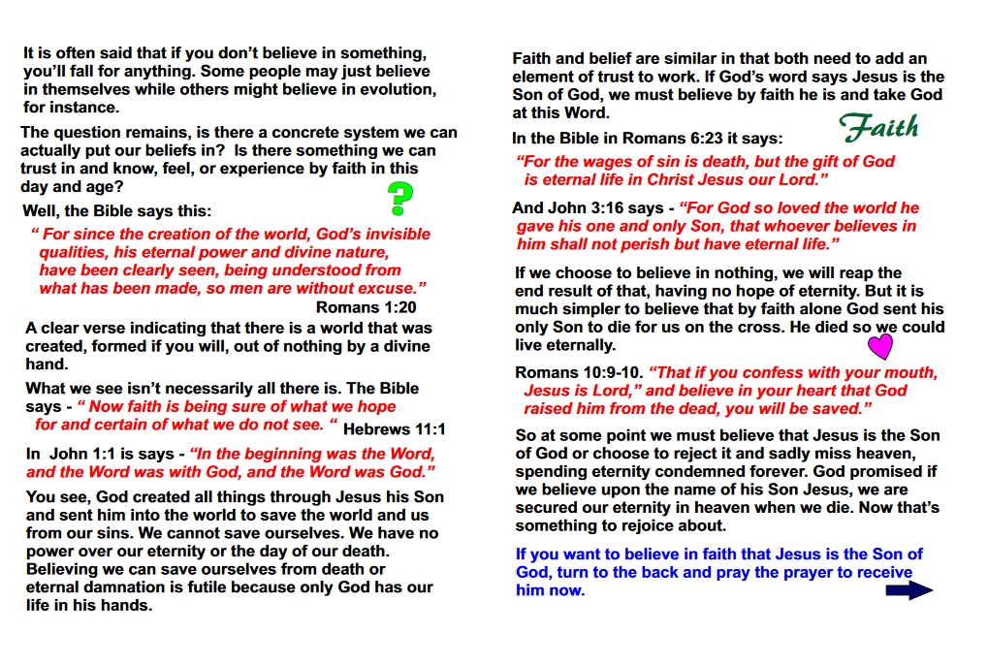
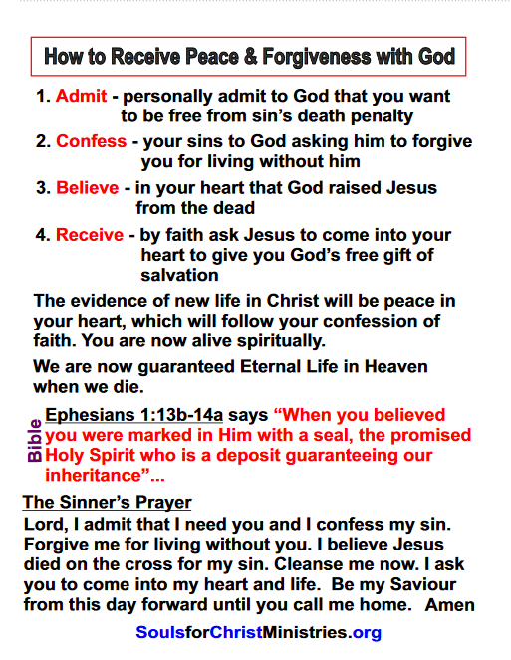

Slide 3

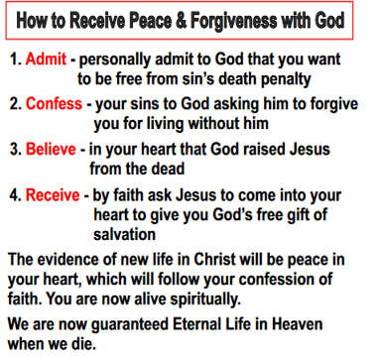

Slide 4
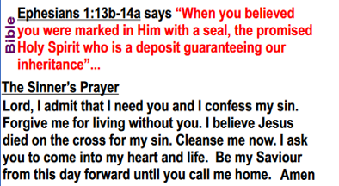

Slide 5
Be taught the proper context of the three main verses that were used.
Understand that confessing your sins isn’t necessary to be given eternal life.
Realize that asking Jesus to come into your heart is a senseless platitude.
Find out that you don’t really feel any different after you’re saved than you did beforehand (with the exception of a few emotional highs here and there, which every sports fan knows about too.)
Praying is a good thing, and is advisable, but belief is all that is necessary for soul salvation.

Slide 6


Slide 7
Three Ironclad Rules of Bible Study
Always look at who is writing or speaking (Who is talking?)
Always find out to whom is being written or spoken (Who are they talking to?)
Always understand the context in which it is being written or spoken (What are they talking about?)

Slide 8
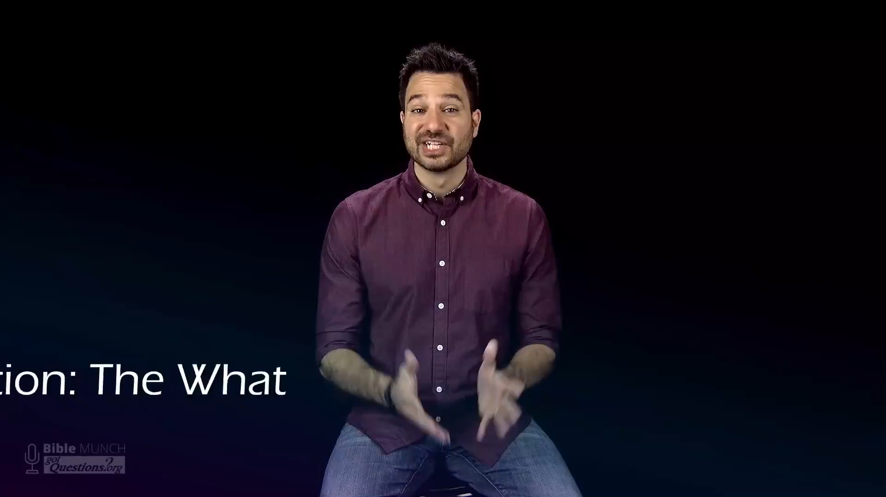

Slide 9
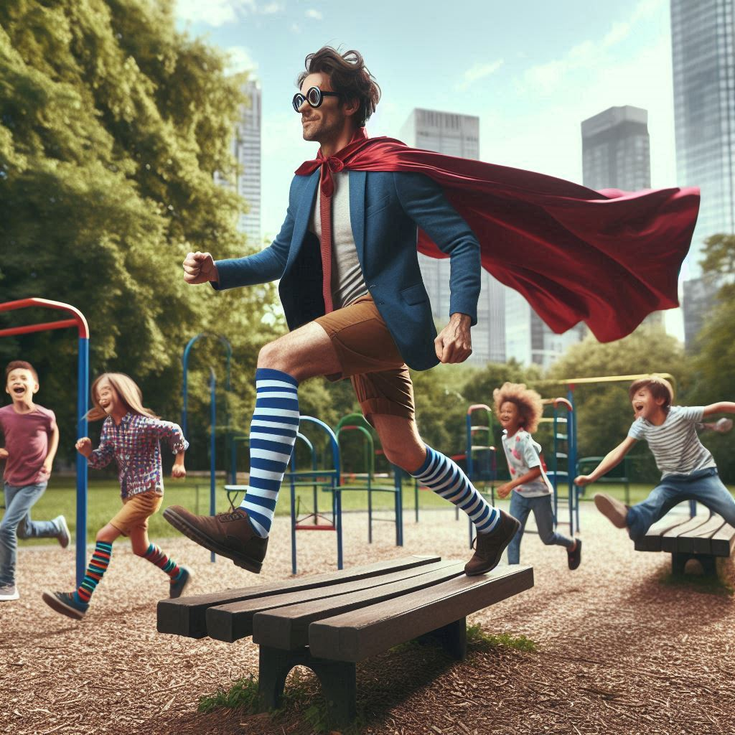
Hyper-man
To the
Rescue!

