Slide 1
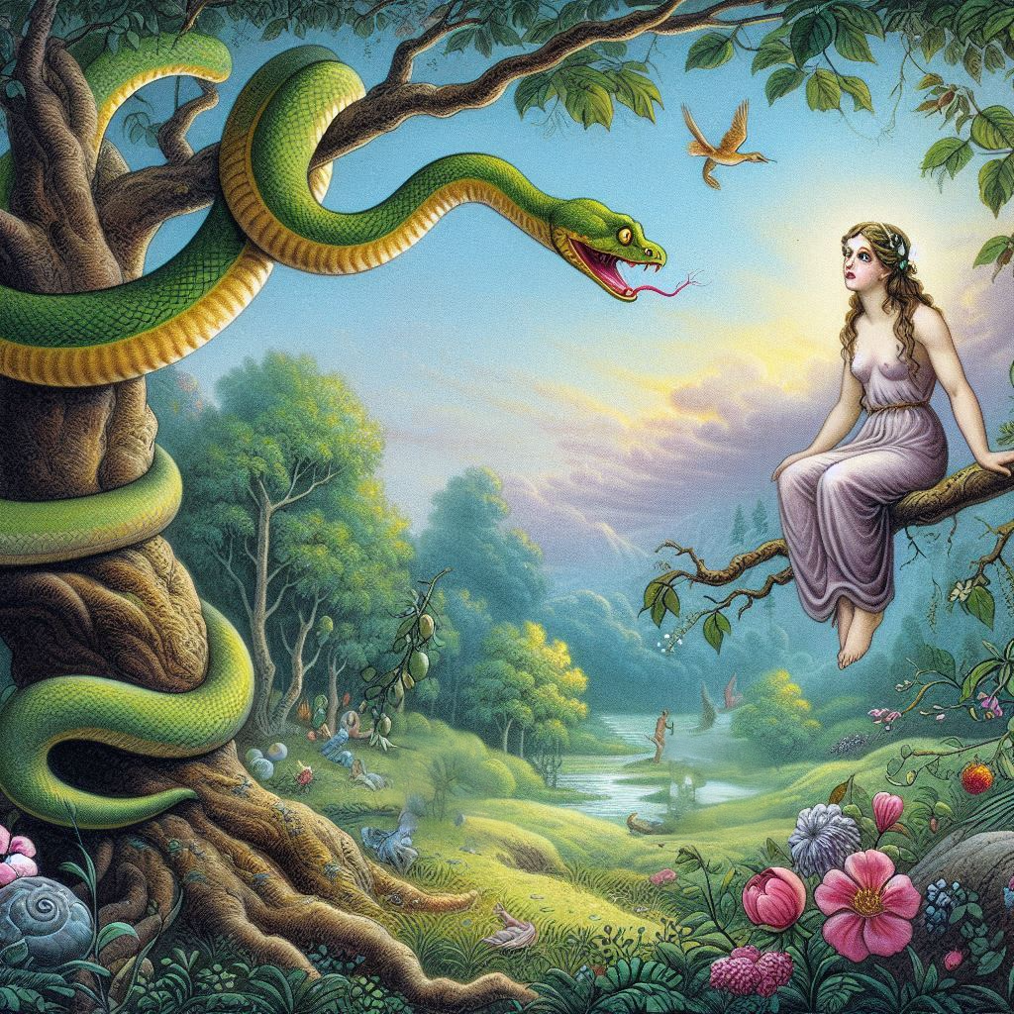
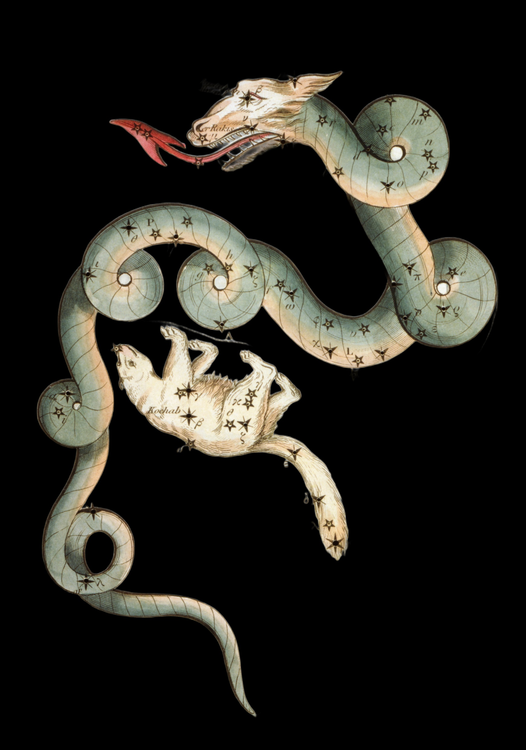
The Serpent

Slide 2
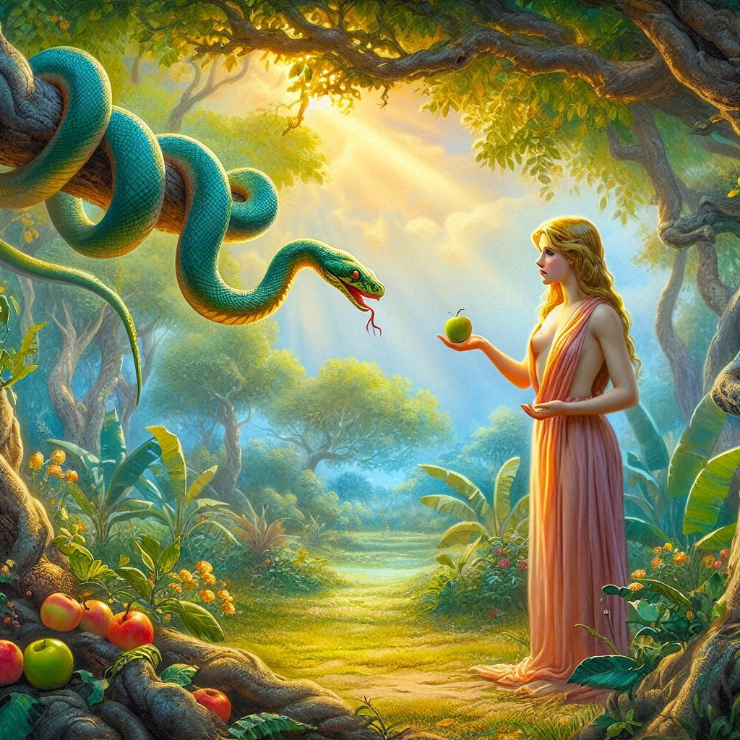

Slide 3
In Genesis, the serpent was used in the temptation process. After man sinned, God placed a curse on the serpent by saying, “Upon thy belly shalt thou go, and dust shalt thou eat all the days of thy life” (Gen. 3:14). The implication is that the serpent was once able to travel and move using a method other than crawling on its belly. Researchers in Israel made an amazing discovery several years ago, which reveals that serpents may have originally had legs.

Slide 4
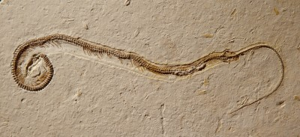
About a quarter of a century ago, several unusual fossils were discovered in a stone quarry at Ein Yabrud near Ramallah, which is in the West Bank area of Israel. These ancient fossils were serpents with two small hind legs. There were three well-preserved snake fossils, and they were considered evidence of the most primitive snakes ever found.

Slide 5
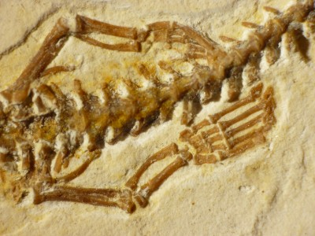
This discovery added credence to the verse in Genesis 3:14, implying that before the serpent was cursed it could communicate and travel in a manner other than crawling. Amazingly, these fossils of serpents with legs were found in Israel not far from Jerusalem, again showing a parallel with the biblical narrative.

Slide 6
The Hebrew word rendered "serpent" in Gen 3:1 is Nachash (from the root Nachash, to shine), and means a shining one. Hence, in Chaldee it means brass or copper, because of its shining. Hence also, the word Nehushtan, a piece of brass, in 2Ki 18:4. In the same way Saraph, in Isa 6:2,6, means a burning one, and, because the serpents mentioned in Num 21 were burning, in the poison of their bite, they were called Saraphim, or Saraphs.

Slide 7
But with the LORD said unto Moses, "Make thee a fiery serpent" (Num 21:8), He said, "Make thee a Saraph", and , in obeying this command, we read in v. 9, "Moses made a Nachash of brass". Nachash is thus used as being interchangeable with Saraph. Now, if Saraph is used of a serpent because its bite was burning, and is also used of a celestial or spirit-being (a burning one), why should not Nachash be used of a serpent because its appearance was shining, and be also used of a celestial or spirit-being (a shining one)?

Slide 8
Figures of speech:
Dan shall be a serpent by the way
the dragon, that old serpent, which is the Devil, and Satan
great red dragon
leviathan the piercing serpent
leviathan that crooked serpent

Slide 9
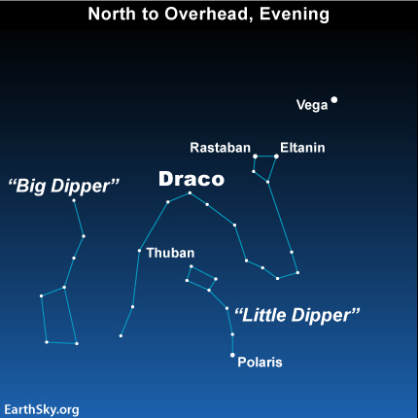
(North Star)

Slide 10
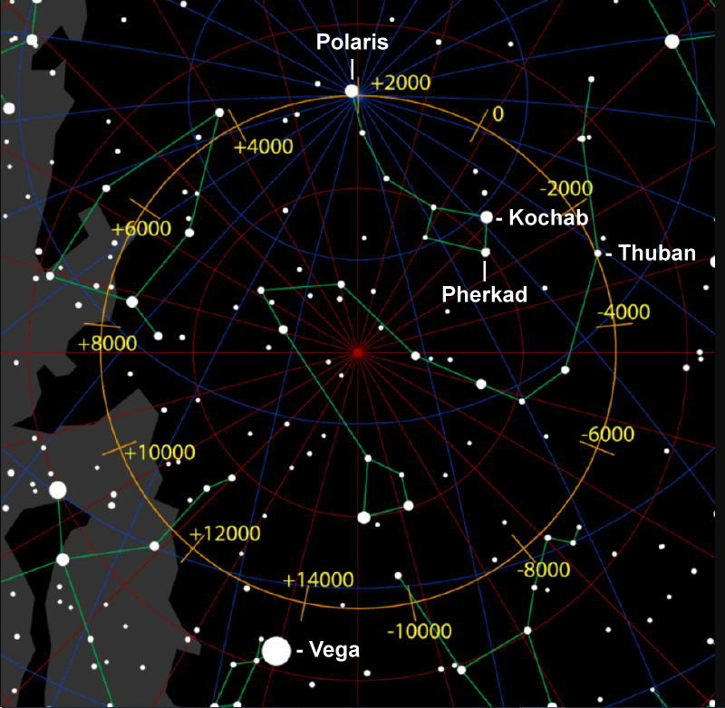
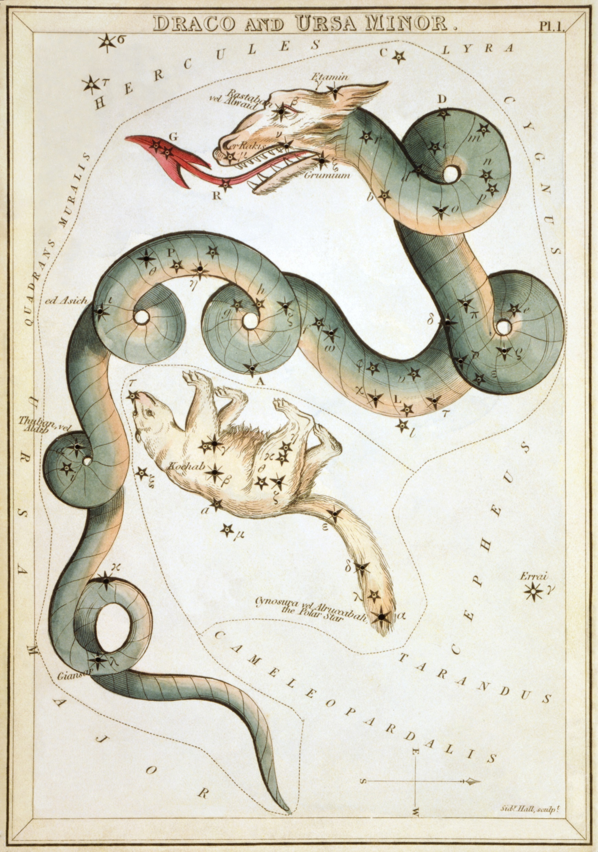



Slide 11
Who were the gods in Eden?
Satan had said: “I will be like the Most High.”
He tempts Eve by telling her they will be like gods (plural).
Satan was in Eden.
God was in Eden
Some of the angelic host would also have been in Eden.
The ‘gods’ that she was tempted to be like were the angelic host.

Slide 12
