Slide 1

Satan’s Devices

Slide 2
DEVICE, noun [Latin]
1. That which is formed by design, or invented; scheme; artificial contrivance; stratagem; project; sometimes in a good sense; more generally in a bad sense, as artifices are usually employed for bad purposes.

Slide 3
To separate grace from truth.
To judge others by our own standards and not the Word of God rightly divided.
Corrupting the Word of God.

Slide 4
KJV
Study to shew thyself approved unto God, a workman that needeth not to be ashamed, rightly dividing the word of truth.
ESV
Do your best to present yourself to God as one approved, a worker who has no need to be ashamed, rightly handling the word of truth.
NIV
Do your best to present yourself to God as one approved, a worker who does not need to be ashamed and who correctly handles the word of truth.

Slide 5
STUDY, verb transitive
1. To apply the mind to; to read and examine for the purpose of learning and understanding; as, to study law or theology; to study languages.
2. To consider attentively; to examine closely. study the works of nature.
DO, verb transitive or auxiliary
1. To perform; to execute; to carry into effect; to exert labor or power for brining any thing to the state desired, or to completion; or to bring any thing to pass. We say, this man does his work well; he does more in one day than some men will do in two days.

Slide 6
KJV
Study to shew thyself approved unto God, a workman that needeth not to be ashamed, rightly dividing the word of truth.
ESV
Do your best to present yourself to God as one approved, a worker who has no need to be ashamed, rightly handling the word of truth.
NIV
Do your best to present yourself to God as one approved, a worker who does not need to be ashamed and who correctly handles the word of truth.

Slide 7
DIVIDE, verb transitive
1. To part or separate an entire thing; to part a thing into two or more pieces.
HAND'LE, verb transitive
4. To treat; to discourse on; to discuss; to use or manage in writing or speaking. The author handled the subject with address. The speaker handled the arguments to the best advantage.
5. To use; to deal with; to practice.

Slide 8
To separate grace from truth.
To judge others by our own standards and not the Word of God rightly divided.
Corrupting the Word of God.
Ministering the letter of the new testament.
Handling the word of God deceitfully.

Slide 9
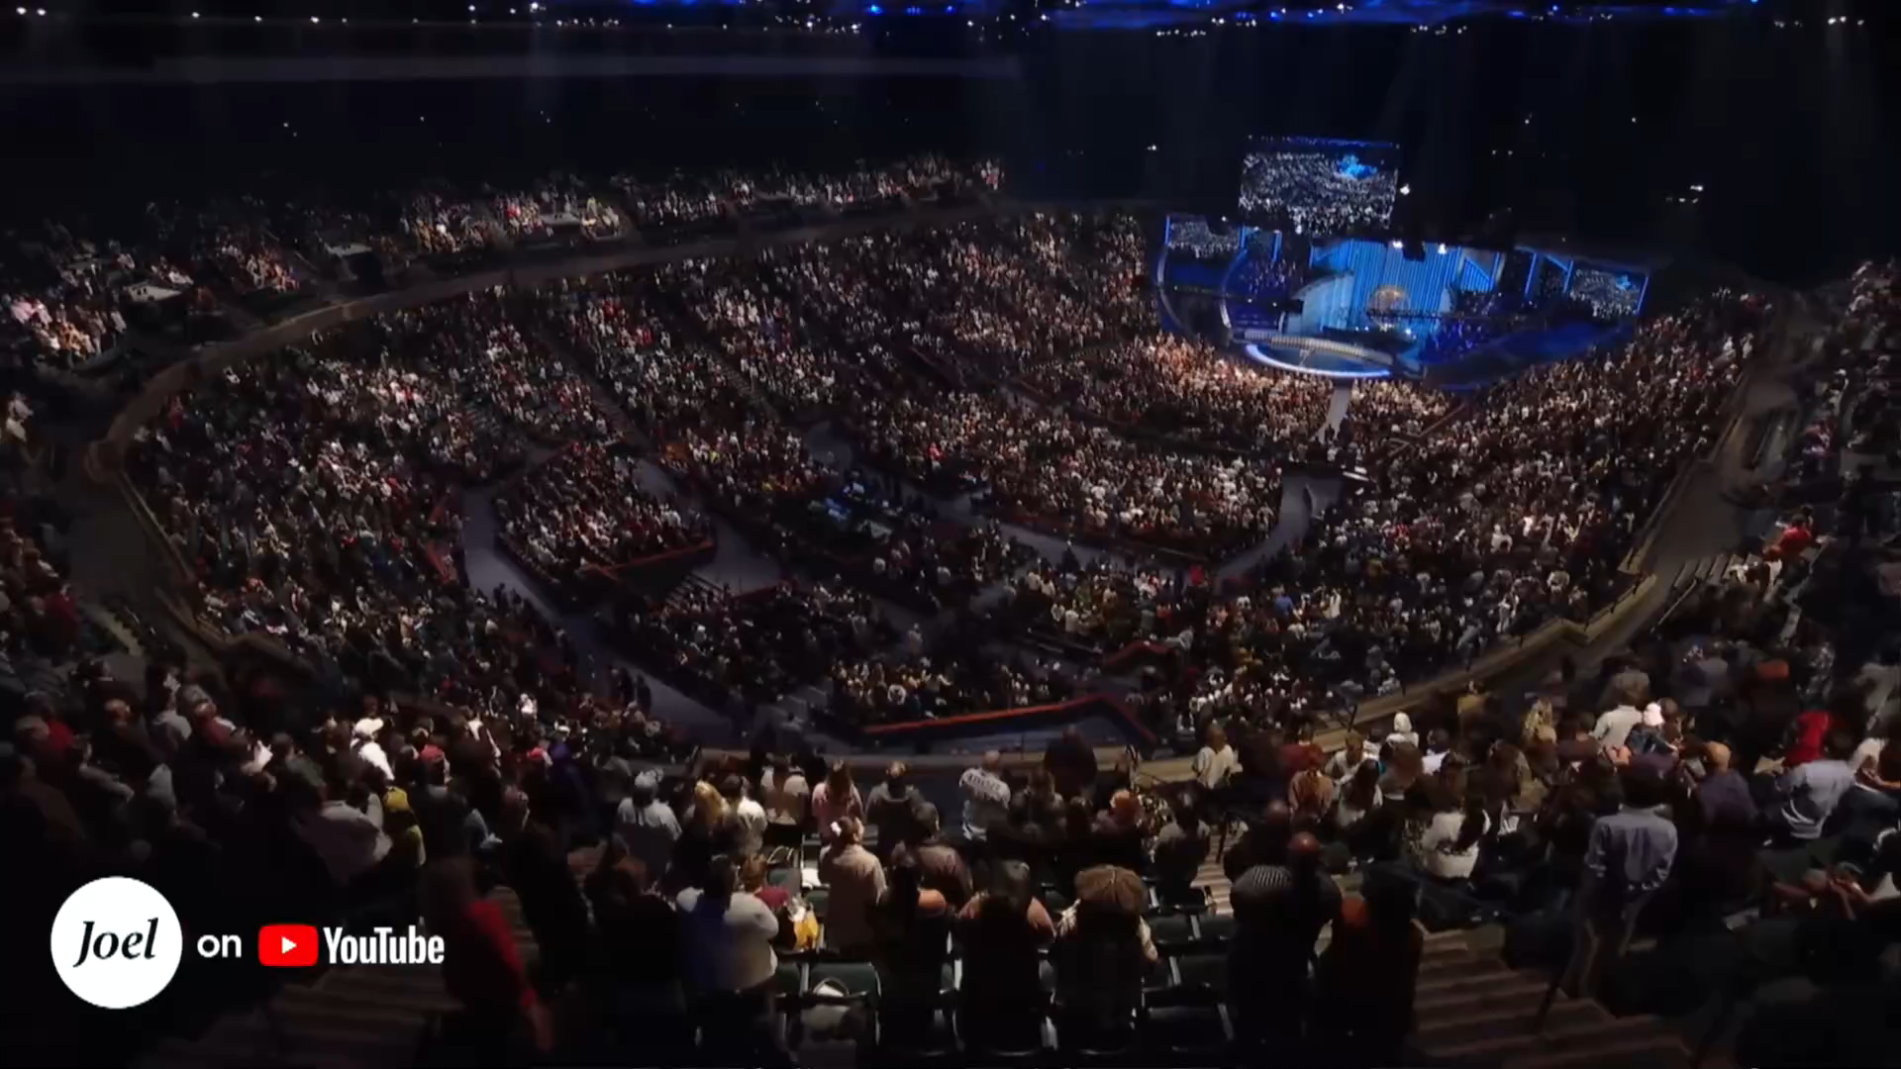

Slide 10
Next Week: Satan’s Devices
In whom the god of this world hath blinded the minds of them which believe not, lest the light of the glorious gospel of Christ, who is the image of God, should shine unto them.
How?

